Slide 1
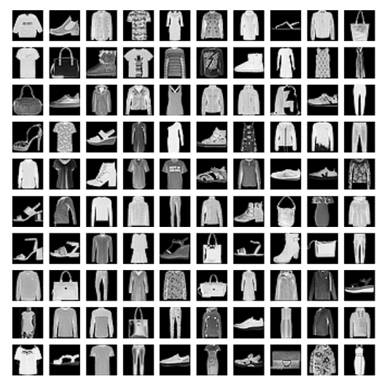
How do you know it‘s a Shirt?
Implementation and comparison of K-nearest neighbors (KNN) and convolutional neural network (CNN) for clothes recognition
Topic 01
Group 04
Anastasia Warken, Bastian Mucha, Heinrike Gilles, Ole Decker

Slide 2
1. Material
Dataset
Overview
2. Methods
Data preparation
KNN
CNN
Evaluation
3. Results
Optimal k und PCs
Accuracies
Run time
T-Shirt/Top vs Shirt problem

Slide 3
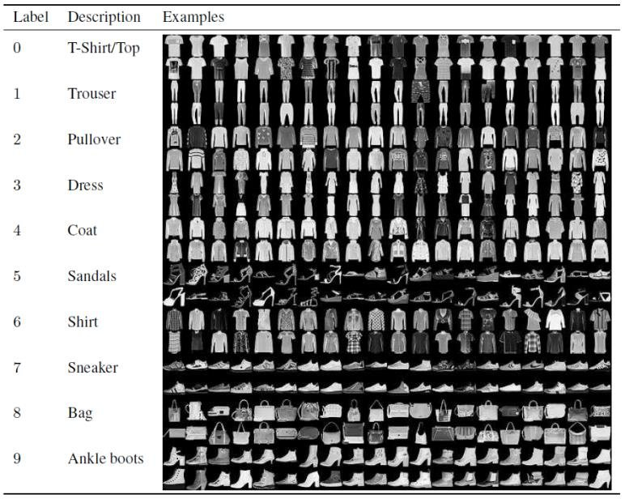
MATERIAL
Fashion-MNIST Dataset
Training set 60.000 images
Test set 10.000 images
28 x 28 pixels grayscale
CSV files (Comma-separated values)
One Row = one image
Intensity values: 0 - 255
Fashion-MNIST Dataset Images with Labels and Description II. LITERATURE... | Download Scientific Diagram (researchgate.net)
Notes:
MNIST: Modified National Institute of Standards and Technology database
Training set 60.000 images
Test set 10.000 images
28 x 28 pixels grayscale
10 different classes (noted in first column)
CSV files (Comma-separated values)
Size-normalized & centered (visually)
each row is one image with values from 0 to 255

Slide 4
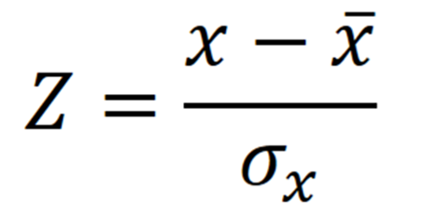
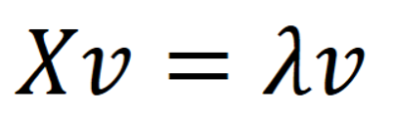
METHODS
Data preparation
Z-transformation
Principal Component Analysis (PCA)

Slide 5
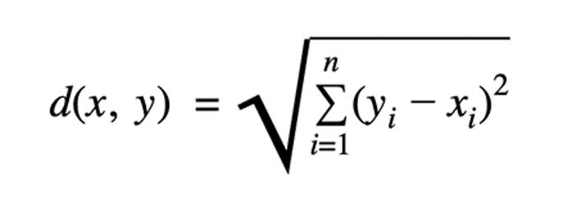
METHODS
K-nearest neighbors (KNN)
nonparametric, supervised learning algorithm
For classification problems
Predictions based on similarity to training data points
Majority vote

Slide 6

METHODS
Convolutional Neural Network (CNN)
deep learning model
for analysis of visual data
detects patterns in a hierarchical structure
different types of layers
Basic CNN Architecture: Explaining 5 Layers of Convolutional Neural Network | upGrad blog
Notes:
Deep learning model as opposed to KNN (lazy learning model)
Different types of layers:
Convolution layer: Multiple convolutional filters: Filter is applied on input image and the product passes onto the next layer
Filters become more and more complex: Filters of first convolutional layers simple: Edge detection etc. and filters from deeper layers recognize more complex shapes
After each convolutional layer: Activation function (Rectified linear unit ReLU), determines, what neurons are activated
Pooling layers: Reduce spacial dimensions of input image -> condenses features in a region
Fully connected layer: Neuron: Transformation is applied to input vector through a weights matrix, then activation function is applied
Output: Different probabilities for each class

Slide 7
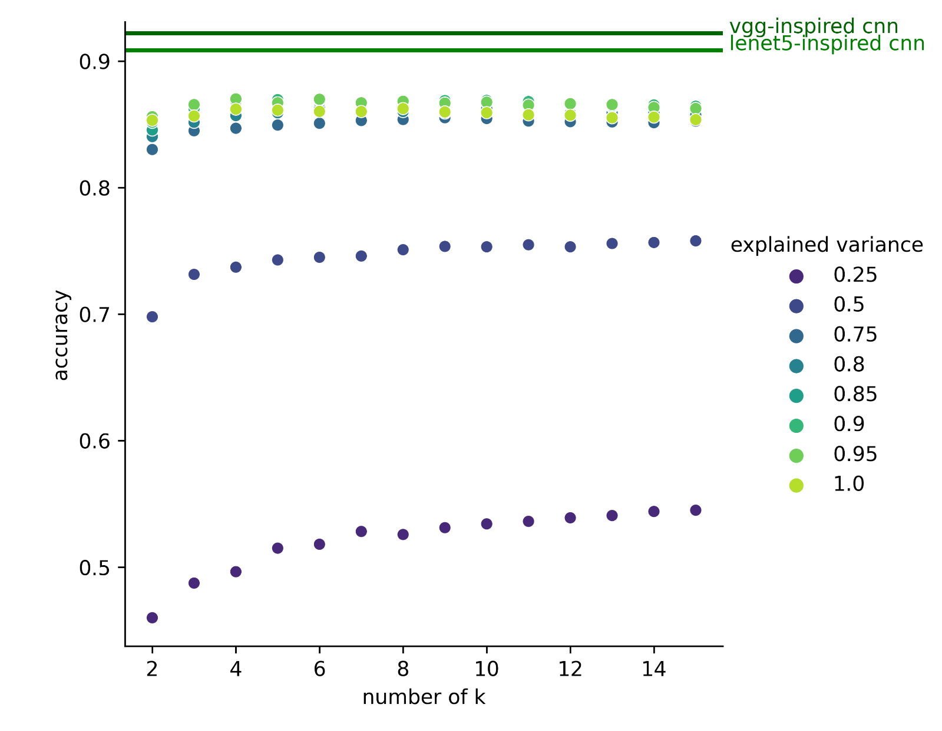
RESULTS
PCA
Optimal number of k and PCs
- 784 Eigenvectors
Optimal k = 4
Variance 95%
256 Eigenvectors

Slide 8
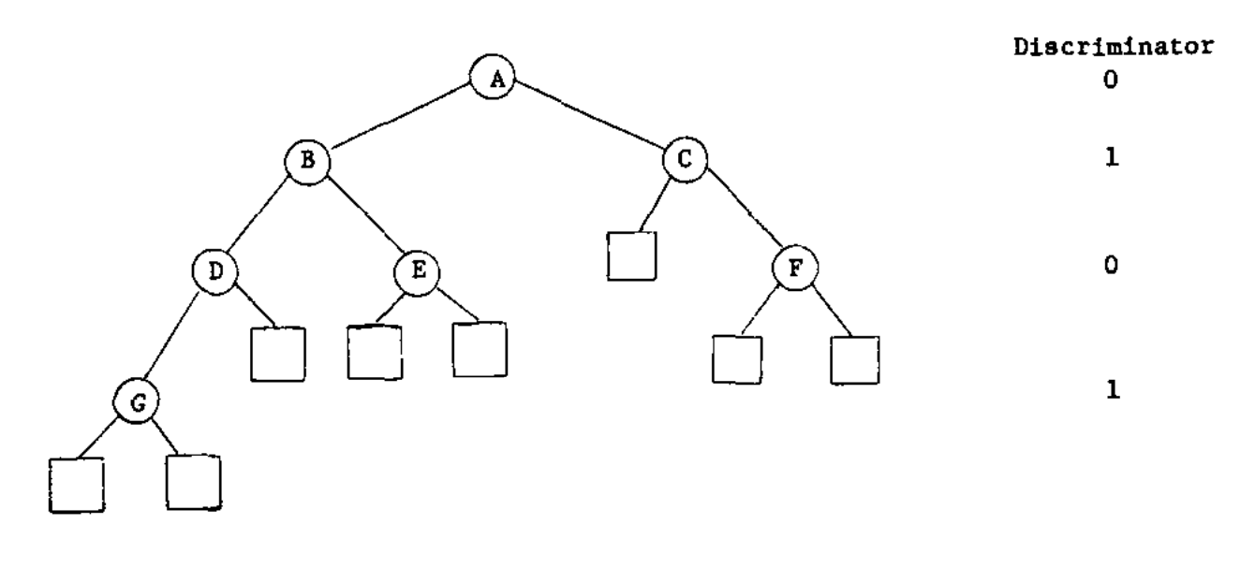
RESULTS
KNN
What‘s a KD-Tree?
Dividing space along median value of each dimension
Each node is a splitting plane
How many times do we split the space with planes? -> Defined by leaf size
Tracing tree to find points with shortest distance
- Run time 40 images: 26.4 seconds
KNN with KD-Tree
Run time 10,000 images: 26.9 seconds
Leaf size 10
Accuracy: 86.3%
Notes:
For 40 images: Runtime o 26.4 seconds, however for all 10000 images the knn could not be performed at one time -> Splitting into batch sizes
Solution: Implementing an algorithm that speeds up the KNN
K-dimensional-Trees: Algorithm that prevents having to compute all euclidean distances
Dividing space with hyperplanes along median value (one half on one side of hyperplane, other half on other side of hyperplane)
Rotating through each dimension
How often do we split the space? Defined by the leaf size: Maximum number of data points that can be contained in a final node at the bottom of the KD-tree
Smaller leaf size: Deeper tree, bigger leaf size: Smaller tree
Achieved a significantly improved run time of 26.9 seconds for a leaf size of 10 for all images
Accuracy achieved with the KNN: 86,3%

Slide 9

KD-Tree

Slide 10
KD-Tree

Slide 11
KD-Tree

Slide 12
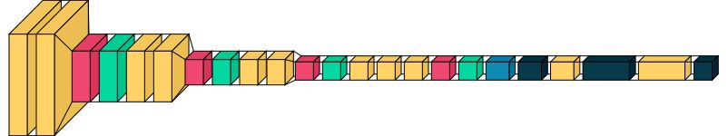
RESULTS
CNN
KNN
Training took between 30 and 60 minutes depending on the model
Our model: Modified VGG (visual geometry group) model
Accuracy: 92.9%
Accuracy: 86.3%
Notes:
Training: Took between 30 and 60 minutes depending on the trained model and device
Tried out different models with different complexities and agreed on a modification and simplification of the Visual Geometry Group VGG model
Yellow: Convolution layers
Red: Pooling layers
Turquoise: Batch normalization (normalizes outputs from first layer to use them as input for the next)
Dark blue: Fully connected
Yellow (end): Neuron dropout
Achieved accuracy of 92,9% compared to KNN 86,3%

Slide 13
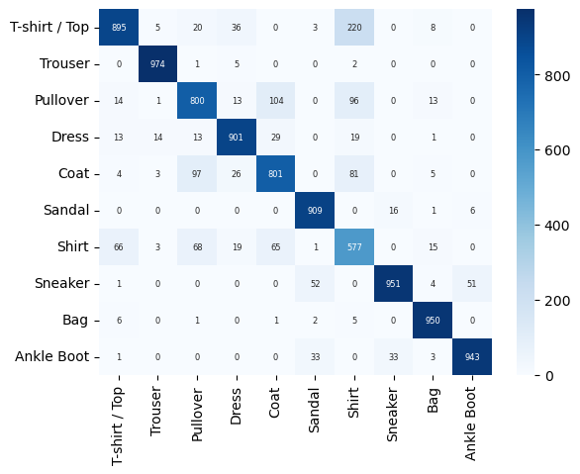
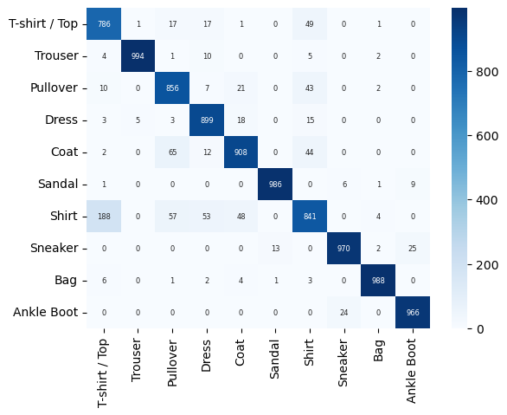
RESULTS
Confusion matrices
KNN
CNN
Where Highest confusion?
Klassifizierungsentscheidung bei tie
Was war hier besser?

Slide 14
RESULTS
Confusion matrices
KNN
CNN
Where Highest confusion?
Klassifizierungsentscheidung bei tie
Was war hier besser?

Slide 15
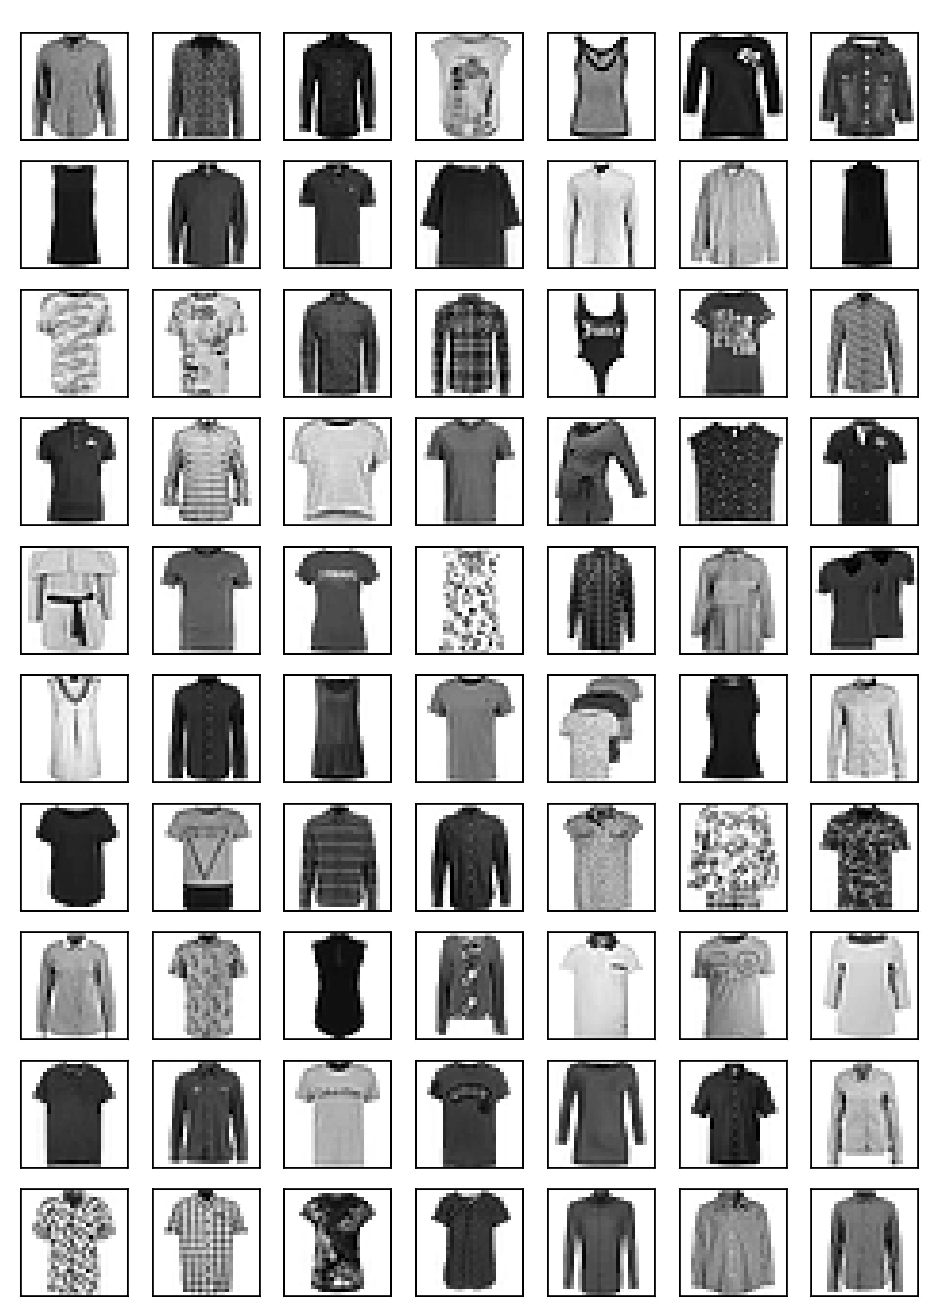
RESULTS
T-Shirt/Top vs. Shirt problem
?

Slide 16
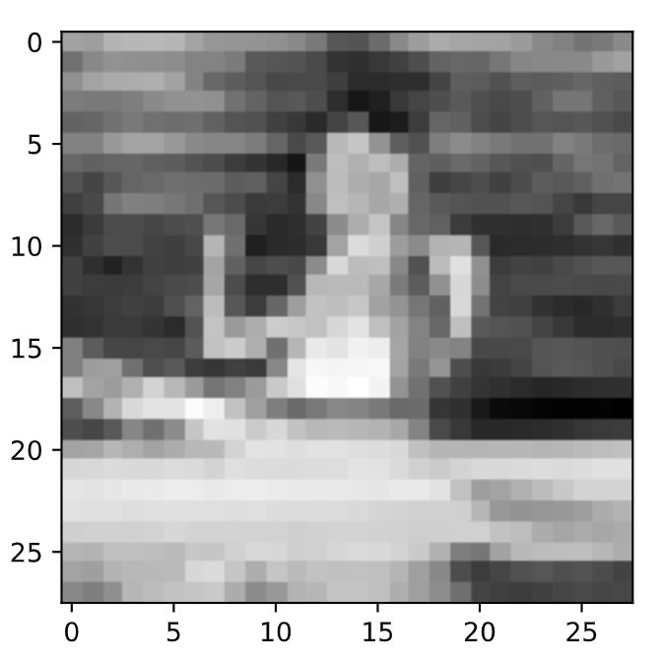
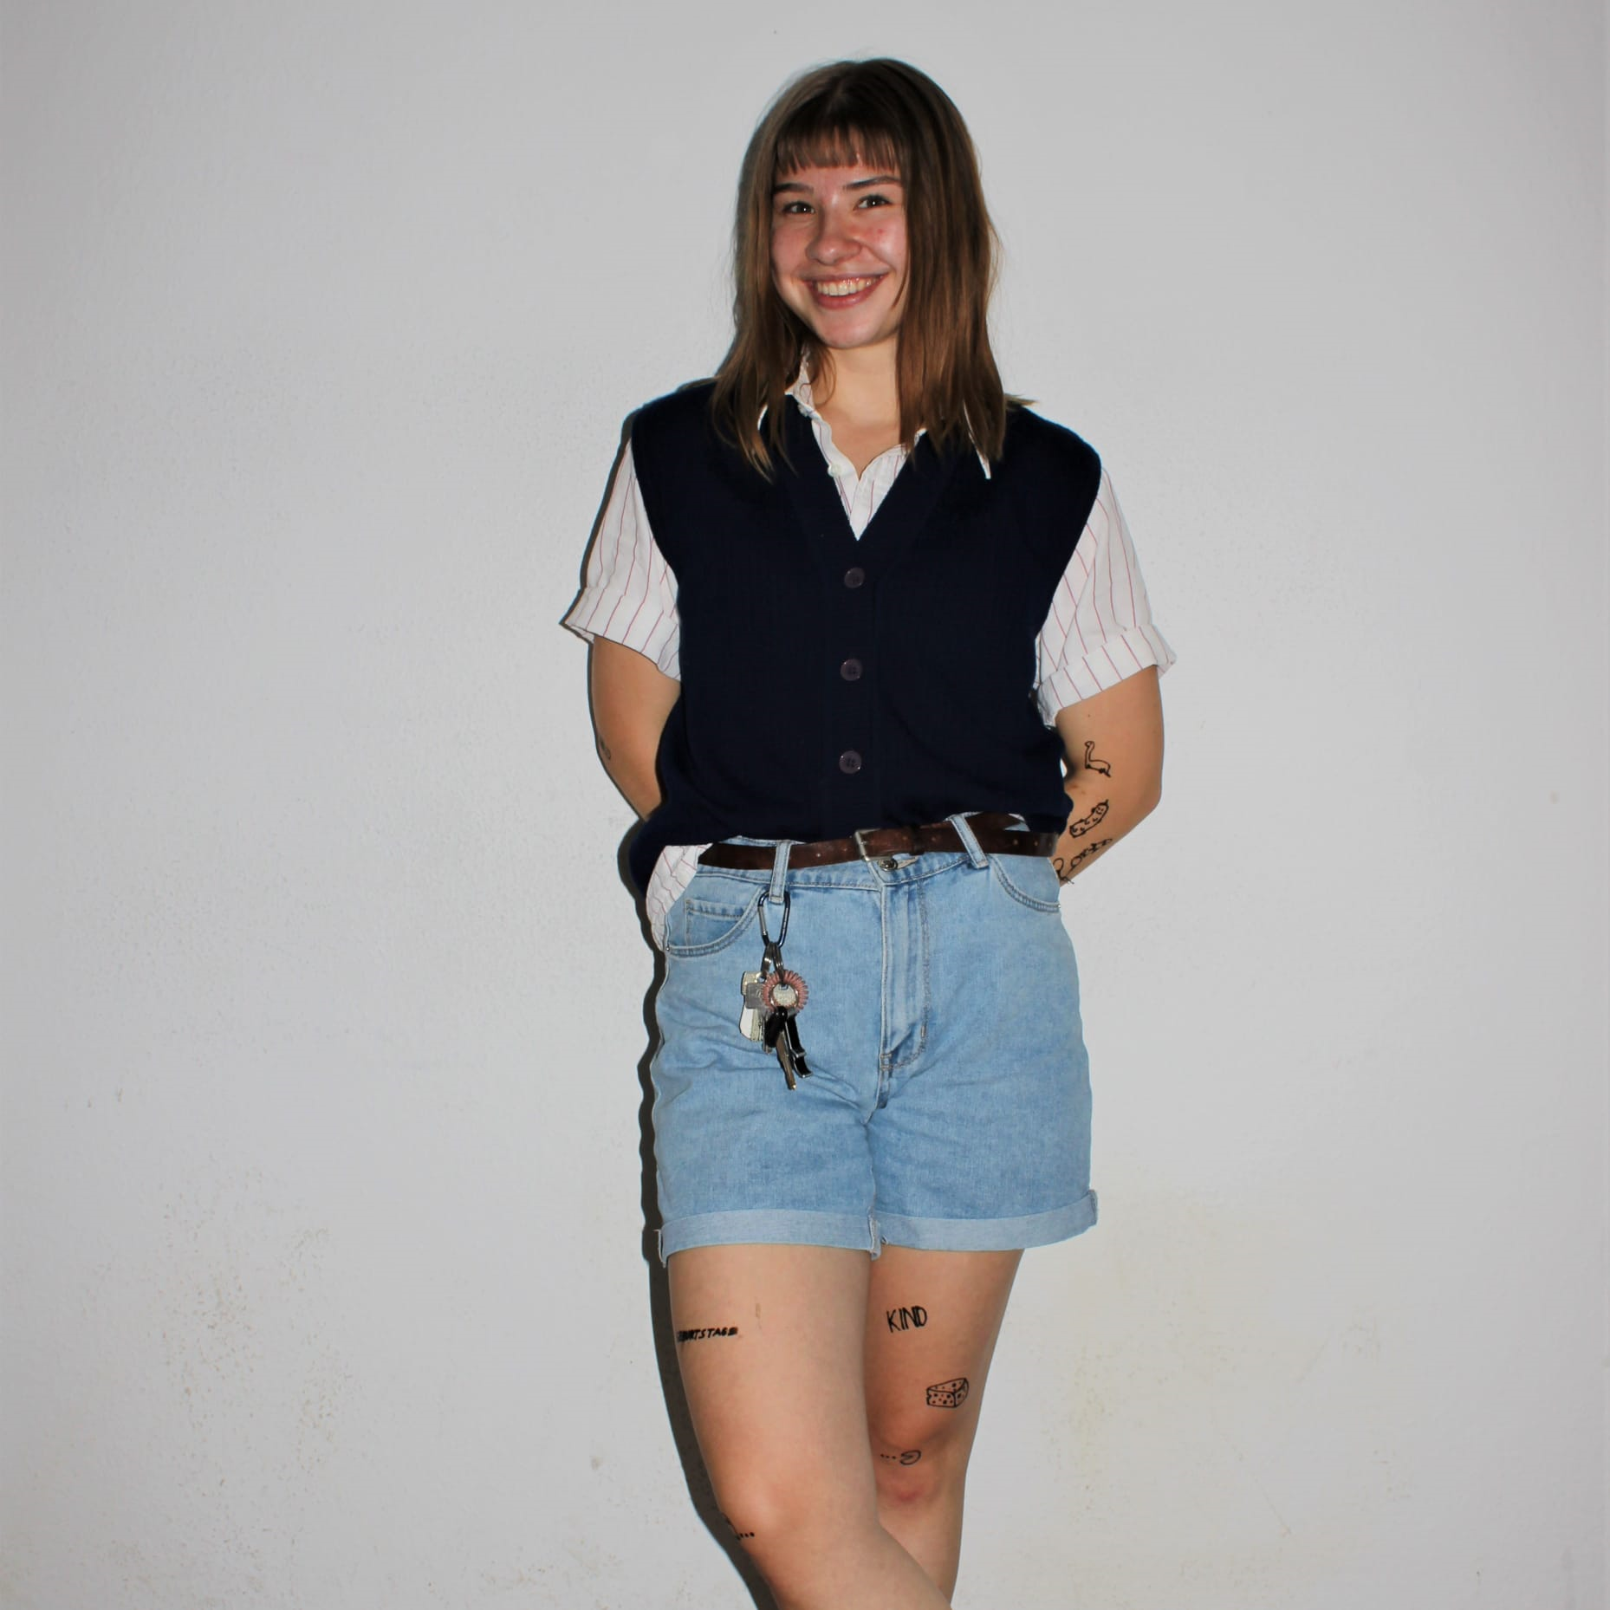
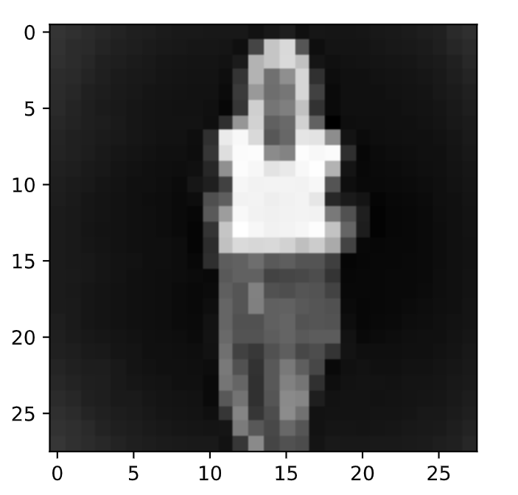
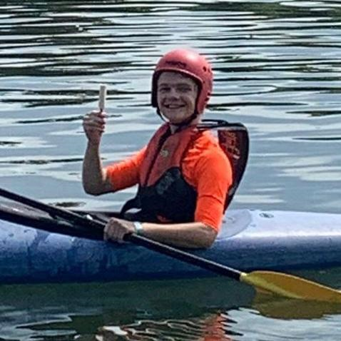
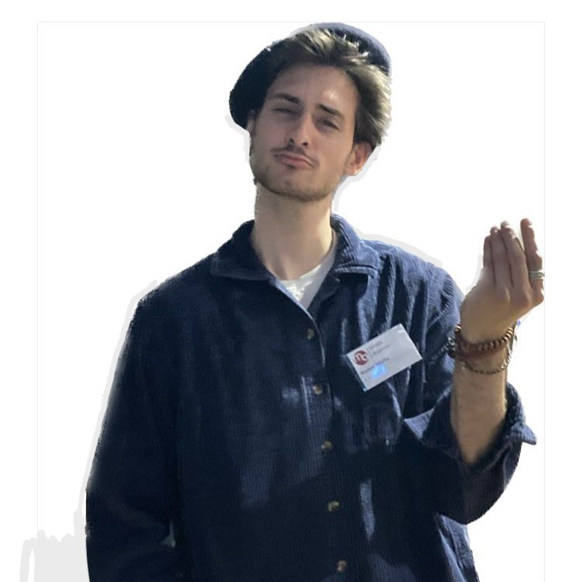
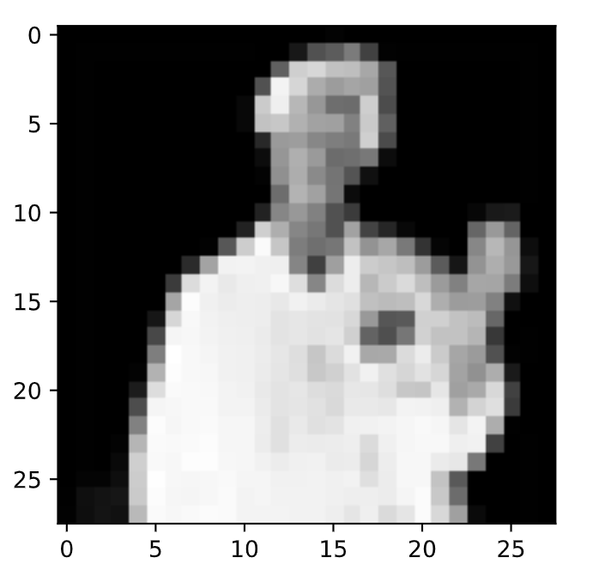

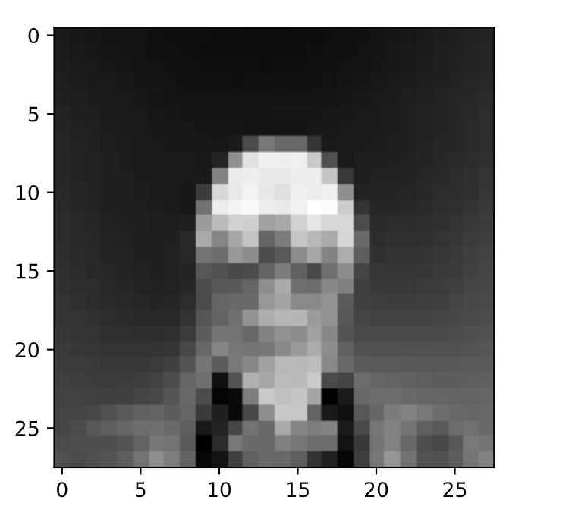
Our Team
Ole Decker
Shirt
Heinrike Gilles
Trousers
CNN quickly reaches its limit when dealing with pictures of people wearing clothes
Bastian Mucha
Sandal
Anastasia Warken
Ankle Boot

